Slide 1
Project Title: Sea Eagle Chemical Supply Strategy Review
Business Case/objectives
To reduce chemical operating costs and ensure uninterrupted production chemical availability
Potential Benefits & Measurement
$150k annual opex reduction
Improved chemical availability
Project Scope/Actions
Scope
The following chemical applications shall be covered :
Demulsifier
Scale Inhibitor
Water Clarifier
The pool of vendors whose products will be assessed are:
Nalco Energy Services
LBENERG
Eunisell Chemicals
Production Chemicals Nigeria
Deliverables
Chemical Screening of alternative products
Field Trials of selected chemicals
Decreased total cost of ownership of chemical applications in scope
Critical Success Factors
Discipline and Asset Mgt. support and drive
CP support
High-level Timeline
L0-L1:Done
L2:May 18th 2017
L3: May 31st 2017
L4: December 29th 2017
L5: December 29th 2018
Initiative End
LT Sponsor: David Martin
Work stream Lead: Akintunde Atanda
Project Team
Iyalla Collins
Achara Azubuike

Slide 2
L1/L2 - Opportunity Framing
In order to frame the opportunity, an exercise to review the current chemical supply strategy for Sea Eagle was carried out in Q1 2017. This exercise involved the screening of various production chemicals in order to identify more cost-effective products when compared with the existing products being used. The screening exercise covered three major chemical applications – Demulsifier (for oil/water separation), Water Clarifier (for produced water treatment) and Scale Inhibitor (for solid deposition management. The results of the exercise are captured in the flow chart below
Chemical Application | Product | Price per Liter ($/L) | Estimated Potential Annual Savings ($)
Demulsifier | Nalco EC2206A (Incumbent) | 8.34 | 0
 | Eunisell PT 12172 | 4.74** | 190K
 | PCN D9031 | 3.71 | 241K
Water Clarifier | Lbenerg WWC 6102 (Incumbent) | 4.52 | 0
 | PCN WWC 9917 | 3.24 | 67K
 | Nalco CLAR 08187 | 6.68* | -113K
Scale Inhibitor | Nalco EC6080A (Incumbent) | 6.30 | 0
 | Lbenerg WFT 9203 | 4.94 | 57k
Technical Evaluation
Based on laboratory results, the following products emerged as possible candidates:
HSE Evaluation
Preliminary
Economic Evaluation
For preliminary analysis purposes, the annual cost associated with each chemical was estimated using the unit cost of each product at existing concentrations being applied in the field. Based on this, the following products are proposed for field trials:
Demulsifier - Eunisell PT12172, PCN PC D9031 and Nalco EC 2206A
Water Clarifier - Eunisell FlocTreat 7842, PCN PC WC9917, Nalco CLAR08187
Scale Inhibitor - Lbenerg WFT 9203, Nalco EC 6080A
Of the screened products only Eunisell FlocTreat 7842 was highlighted on grounds of HSE concerns. This is because of its high toxicity to aquatic life at concentrations which may be in the neighborhood of those expected to be contained in the effluent water discharge overboard.
Demulsifier (PCN PC D9031 and/or Eunisell PT 12172)
Scale Inhibitor WFT 9203
Water Clarifier PCN PC WC9917
In total, these products present a combined opportunity to save $300 - $350k annually (high case). See table for details
** - Latest estimated from C & P Negotiations with vendor
* - Un-negotiated estimate

Slide 3
L2 – Execution Plan
Action | Timeline
Demulsifier Field Trial
Complete price agreements for shortlisted products | 4th May 2017
Secure Temporary MoC for Trial | 31st May 2017
Order trial stock | 1st June 2017
Mobilize to site | 26th June 2017
Commence field trial | 30th June 2017
Complete final evaluation | 15th July 2017
Secure permanent MOC | 31st July 2017
Scale Inhibitor Field Trial
Complete price agreements for shortlisted products | Completed
Secure Temporary MoC for Trial | 31st August 2017
Order trial stock | 8th August 2017
Mobilize to site | 5th September 2017
Commence field trial | 12th September 2017
Complete final evaluation | 30th September 2017
Secure permanent MOC | 15th October 2017
Water clarifier trial is planned for 2018 as available inventory of incumbent product will last all through 2017

Slide 4
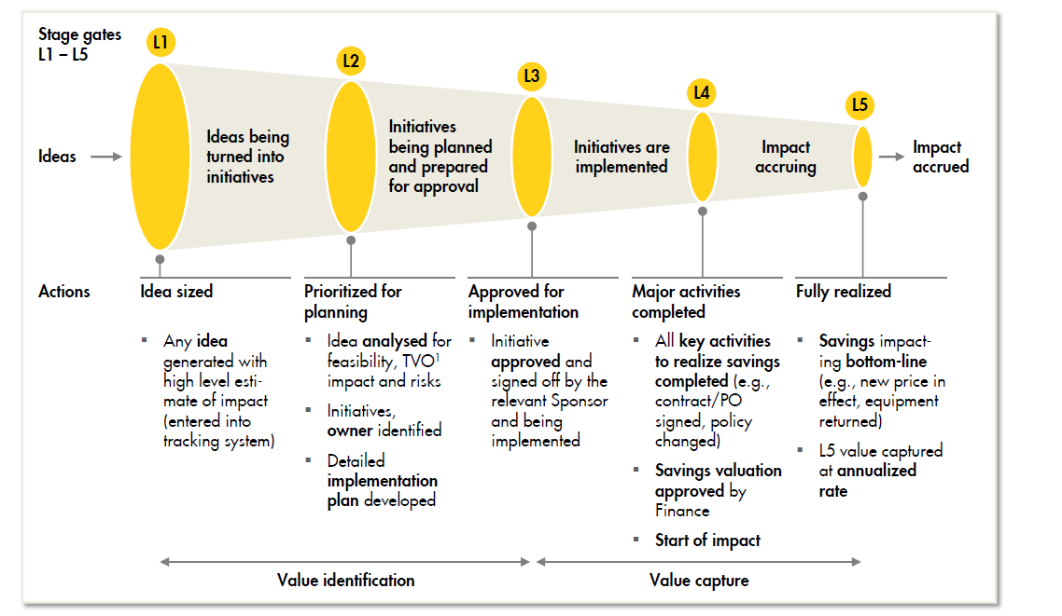
Guide on the Stage Gates

